Slide 1


Java ee
(ADVANCE JAVA)
Lecture-14

Slide 2
Today’s Agenda
Introduction To Initialization Parameters
Using Servlet Initialization Parameters
Using Context Initialization Parameters
Using Context Listener
Improving The Code

Slide 3
INITIALIZATION PARAMETER
While designing the web application , there are data elements of our servlet that needs to be changed in future.
For ex: Suppose our servlet is using the company’s email id, then we can write it in a way:
pw.println(“you can contact us at :scalive4u@gmail.com”);

Slide 4
INITIALIZATION PARAMETER
But suppose this id changes in future . So to reflect this change in our servlet we have to do the following three steps:
Rewrite source code of servlet
Recompile it
Redeploy it
All the above tasks are time consuming so to avoid these we use technique called as initialization parameters.

Slide 5
CREATING & READING INITIALIZATION PARAMETERS
Initialization parameters are textual values coded external to the servlet within DD(deployment descriptor) called web.xml
From the body of servlet’s doGet() and doPost() method we read these values and use them.
Now , if in future the data changes we only have to update web.xml.

Slide 6
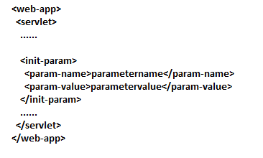
SYNTAX OF INITIALIZATION PARAMETER

Slide 7
THE web.xml FILE
<web-app>
<servlet>
<servlet-class>MyInitParamServlet</servlet-class>
<servlet-name>MyInitParamServlet</servlet-name>
<init-param>
<param-name>emailid</param-name>
<param-value>scalive4u@gmail.com</param-value>
</init-param>
<init-param>
<param-name>phoneno</param-name>
<param-value>9826086245</param-value>
</init-param>
</servlet>
<servlet-mapping>
<servlet-name>MyInitParamServlet</servlet-name>
<url-pattern>/MyInitParamServlet</url-pattern>
</servlet-mapping>
</web-app>

Slide 8
READING INITIALIZATION PARAMETERS
To read initialization parameters we need to do the following:
Obtain the object of ServletConfig.
Call the method getInitParameter( ) of ServletConfig object to read the parameter.

Slide 9
OBTAINING ServletConfig OBJECT
To get ServletConfig object we call the method getServletConfig( ) of our super class HttpServlet.
It’s prototype is:
public ServletConfig getServletConfig( )
Sample Call:
ServletConfig cfg=super.getServletConfig( );

Slide 10
READING PARAMETER VALUES
To read the parameter value we have to call the method getInitParameter( ) of the ServletConfig object.
It’s prototype is:
public String getInitParameter(String )
The String passed is the name of parameter and it’s
return value is it’s value which is set in web.xml
Sample Call:
String emaild=cfg.getInitParameter(“emailid”);

Slide 11
THE SERVLET
import java.io.*;
import javax.servlet.*;
import javax.servlet.http.*;
public class MyInitParamServlet extends HttpServlet
{
public void doGet(HttpServletRequest req,HttpServletResponse resp)throws IOException,ServletException
{
resp.setContentType("text/html");
ServletConfig cfg=super.getServletConfig();
String email=cfg.getInitParameter("emailid");
String phno=cfg.getInitParameter("phoneno");
PrintWriter pw=resp.getWriter();
pw.println("<html><head><title>Welcome User</title>");
pw.println("<style type='text/css'>");
pw.println(".imp{color :rgb(104,0,0);}");
pw.println("</style>");
pw.println("</head>");
pw.println("<body>");
pw.println("<h2>Demonstration Of Init Parameters!</h2>");
pw.println("<b>emailid:</b><span class='imp'>"+email+"</span><br>");
pw.println("<b>phone number:</b><span class='imp'>"+phno+"</span>");
pw.println("</body></html>");
pw.close();
}
}

Slide 12
CONTEXT-PARAMETERS
Servlet initialization parameter are created for a specific servlet only.
This means that they are are available to only that servlet which created them.
But in many cases we might want to access these parameters in multiple servlets

Slide 13
CONTEXT-PARAMETERS
For ex : in login and register application :
We have two servlets called LoginServlet and RegistrationServlet and both the servlets are interacting with the database so both of them needed four things:
Driver name
Connection string
Username
Password

Slide 14
CONTEXT-PARAMETERS
In this situation it is not sensible to set these parameters local to servlet because we have to write the same entries multiple times in web.xml.
Thus a much better approach is to configure them in such a way that they have to be written only once in web.xml and become available to all servlets.

Slide 15
CONTEXT-PARAMETERS
This is done by using context parameters.
Context parameters in java are global declaration in web.xml and become available to all the servlets.

Slide 16
CONTEXT-PARAMETERS v/s INTIALIZATION PARAMETRS
Initialization Parameters are local to servlet, while context-parameters are global.
Initialization Parameters are coded inside <servlet> tag , while context-parameters are coded inside <web-app> tag outside any <servlet> tag.
Initialization Parameters are read using ServletConfig object , while context-parameters are read using ServletContext object.
ServletContext object is global and created only once for the entire application while ServletConfig object is created separately for each servlet.

Slide 17
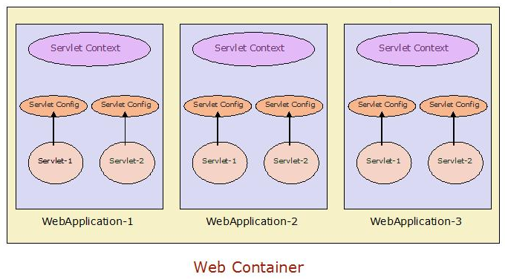
DIAGRAM

Slide 18
THE web.xml FILE
<web-app>
<context-param>
<param-name>emailid</param-name>
<param-value>ksachin95@gmail.com</param-value>
</context-param>
<context-param>
<param-name>phoneno</param-name>
<param-value>07554273659</param-value>
</context-param>
<servlet>
<servlet-class>ServletOne</servlet-class>
<servlet-name>ServletOne</servlet-name>
</servlet>
<servlet-mapping>
<servlet-name>ServletOne</servlet-name>
<url-pattern>/ServletOne</url-pattern>
</servlet-mapping>
<servlet>
<servlet-class>ServletTwo</servlet-class>
<servlet-name>ServletTwo</servlet-name>
</servlet>
<servlet-mapping>
<servlet-name>ServletTwo</servlet-name>
<url-pattern>/ServletTwo</url-pattern>
</servlet-mapping>
</web-app>

Slide 19
READING CONTEXT INITIALIZATION PARAMETERS
To read context initialization parameters we need to do the following:
Obtain the object of ServletContext.
Call the method getInitParameter( ) of ServletContext object to read the parameter.

Slide 20
OBTAINING ServletContext OBJECT
To get ServletContext object we call the method getServletContext( ) of our super class HttpServlet.
It’s prototype is:
public ServletContext getServletContext( )
Sample Call:
ServletContext ct=super.getServletContext( );

Slide 21
READING PARAMETER VALUES
To read the parameter value we have to call the method getInitParameter( ) of the ServletContext object.
It’s prototype is:
public String getInitParameter(String )
The String passed is the name of parameter and it’s
return value is it’s value which is set in web.xml
Sample Call:
String emaild=ct.getInitParameter(“emailid”);

Slide 22
CODING FOR ServletOne
import java.io.*;
import javax.servlet.*;
import javax.servlet.http.*;
public class ServletOne extends HttpServlet
{
public void doGet(HttpServletRequest req,HttpServletResponse resp)throws IOException,ServletException
{
resp.setContentType("text/html");
PrintWriter pw=resp.getWriter();
pw.println("<html><head><title>Welcome To Servlet One</title>");
pw.println("</head>");
pw.println("<body>");
pw.println("<h2>Demonstration Of Context Parameters!</h2>");
ServletContext ctxt=super.getServletContext();
String email=ctxt.getInitParameter("emailid");
String phno=ctxt.getInitParameter("phoneno");
pw.println("<b>emailid:</b>"+email+"<br>");
pw.println("<b>phone number:</b>"+phno);
pw.println("</body></html>");
pw.close();
}
}

Slide 23
CODING FOR ServletTwo
import java.io.*;
import javax.servlet.*;
import javax.servlet.http.*;
public class ServletTwo extends HttpServlet
{
public void doGet(HttpServletRequest req,HttpServletResponse resp)throws IOException,ServletException
{
resp.setContentType("text/html");
PrintWriter pw=resp.getWriter();
pw.println("<html><head><title>Welcome To Servlet Two</title>");
pw.println("</head>");
pw.println("<body>");
pw.println("<h2>Demonstration Of Context Parameters!</h2>");
ServletContext ctxt=super.getServletContext();
String email=ctxt.getInitParameter("emailid");
String phno=ctxt.getInitParameter("phoneno");
pw.println("<b>emailid:</b>"+email+"<br>");
pw.println("<b>phone number:</b>"+phno);
pw.println("</body></html>");
pw.close();
}
}

Slide 24
EXERCISE
Modify the previous application as follows:
Set the driver name, connection url, username and password as context parameters
Set the queries(Select and Insert) as initialization parameters for respective servlets
Modify both LoginServlet and RegistrationServlet so that they now read and use these parameters for getting connected to the DB and setting the queries

Slide 25
EVENT HANDLING IN SERVLETCONTEXT
In the previous example we have designed LoginServlet and RegisterationServlet where inside the init( ) method we have written the code for loading the driver and opening the connection .
We have written the same code in both servlet and it is redundancy of code.
Moreover the code for loading the driver and opening the connection should run only once
It is because both the servlet are communicating with same database so it’s useless to load the driver and open the connection twice.

Slide 26
EVENT HANDLING IN SERVLETCONTEXT
To do this java allows us to write the code for driver loading and connection opening at such a place which gets executed as soon as the application gets deployed and this is called Handling LifeCycle Event of ServletContext.
Whenever the container deploys web application , it creates a ServletContext object for that application.
And when this object is created the container calls a very important method called as contextInitialized( ).

Slide 27
EVENT HANDLING IN SERVLETCONTEXT
This method is available in interface called ServletContextListener and has has the following prototype:
public void contextInitialized(ServletContextEvent e)
This interface contains one more method called contextDestroyed() and this method is called by the container whenever our application gets undeployed (like server-shutdown).
It has the following prototype:
public void contextDestroyed(ServletContextEvent e)

Slide 28
EVENT HANDLING IN SERVLETCONTEXT
Thus if we want to execute some code as soon as the application is deployed (server startup) or just before the application is undeployed(server shutdown) then we have to override these methods and place the desired code into them.
So contextInitialized( ) is used for setting up some global initialization code and contextDestroyed( ) is used for global cleanup of resources

Slide 29
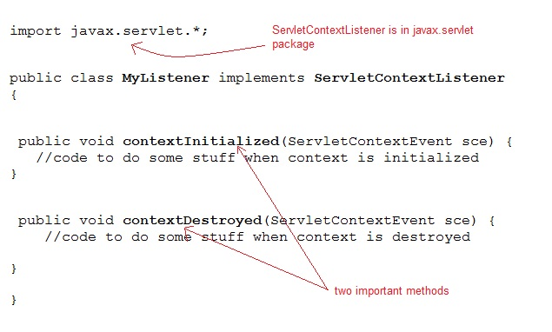
THE ServletContextListener INTERFACE

Slide 30
EVENT HANDLING IN CONTEXT - PARAMETER
Also we have to inform Tomcat about our listener class so that it calls the LifeCycle methods while deploying the application .
To do this we have to make an entry in web.xml file using a tag called <listener>.

Slide 31
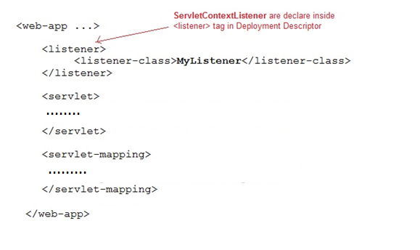
THE web.xml FILE

Slide 32
EVENT HANDLING IN CONTEXT - PARAMETER
So the steps for event-handling in ServletContext would be as follows:
Create a class which implements ServletContextListener interface
Override the methods contextInitialized( ) and contextDestroyed( ) as required
Compile the class and place it’s bytecode in classes subdirectory
Inside the web.xml file create a tag called <listener> and make an entry for the Listener class.
Start the server , which will make Tomcat create the ServletContext object and call the lifecycle methods

Slide 33
PASSING DATA FROM LISTENER TO SERVLET
Java permits us to pass values from our listner class to the servlet .
This is done as follows:
Obtain the ServletContext object in Listener class.
This is done by calling the method getServletContext( ) of the ServletContextEvent object which comes as argument to the method contextInitialized( )

Slide 34
PASSING DATA FROM LISTENER TO SERVLET
Then we can call the method setAttribute( ) of ServletContext object whose prototype is :
public void setAttribute(String name,Object value)
The first argument is the key/name by which the data will be
identified inside ServletContext object and second argument is the
actual data/value we have to pass
Inside the servlet obtain the object of ServletContext and call the method getAttribute() whose prototype is:
public Object getAttribute( String key)
The argument is the key/name it’s return value is the
actual object we have stored in it using the method
setAttribute( )

Slide 35
CODING FOR MyListener
import javax.servlet.*;
public class MyListener implements ServletContextListener
{
public void contextInitialized(ServletContextEvent e)
{
System.out.println("contextinitialized method called. . . ");
ServletContext ct=e.getServletContext();
java.util.Date today=new java.util.Date();
ct.setAttribute("currentdate",today);
}
public void contextDestroyed(ServletContextEvent e)
{
}
}

Slide 36
CODING FOR web.xml
<web-app>
<listener>
<listener-class>MyListener</listener-class>
</listener>
<servlet>
<servlet-class>MyContextParamDemoServlet</servlet-class>
<servlet-name>MyContextParamDemoServlet</servlet-name>
</servlet>
<servlet-mapping>
<servlet-name>MyContextParamDemoServlet</servlet-name>
<url-pattern>/MyContextParamDemoServlet</url-pattern>
</servlet-mapping>
</web-app>

Slide 37
CODING FOR MyContextParamDemoServlet
import javax.servlet.*;
import javax.servlet.http.*;
import java.io.*;
public class MyContextParamDemoServlet extends HttpServlet
{
public void doGet(HttpServletRequest req,HttpServletResponse resp)throws ServletException,IOException
{
resp.setContentType("text/html");
PrintWriter pw=resp.getWriter();
pw.println("<html>");
pw.println("<head><title>Context Demo</title></head>");
pw.println("<body>");
ServletContext ct=super.getServletContext();
java.util.Date dt=(java.util.Date)ct.getAttribute("currentdate");
pw.println("<h2>Welcome To Servlets</h2>");
pw.println("<h3>Date and Time Currently Are:"+dt+"</h3>");
pw.println("</body>");
pw.println("</html>");
pw.close();
}
}

Slide 38
EXERCISE
Modify the userapp application as follows:
Create a Listener class that loads the Driver and Opens the Connection
Send this Connection object to your Servlet
Modify both LoginServlet and RegistrationServlet so that they now use the connection object sent by listener class and if the connection could not be opened then your servlets should throw ServletException to inform TomCat to stop further calling of doGet()/doPost() methods.

Slide 39

End Of Lecture
For any queries mail us @: scalive4u@gmail.com
Call us @ : 0755-4271659, 7879165533
Agenda for Next Lecture:
Transferring Request
Using Redirection
Using Dispatching

